Slide 1



G H RAISONI INSTITUTE OF ENGINEERING AND TECHNOLOGY, NAGPUR
(Approved by AICTE, New Delhi and Recognized by DTE, Maharashtra)
An Autonomous Institute Affiliated to Rashtrasant Tukadoji Maharaj Nagpur University, Nagpur
Accredited by NAAC with A+ Grade
Department of Science and Technology
Introductory Seminar
On
URBAN SPOTTER
GUIDE:Mr.Anupam Chaube
Name of Projectees
Mr. Charanjot Singh Sivia Mr.Ayush Mandpe
Mr. Amruj Lende Mr.Amritpal Singh Bamrah
Mr. Shivam Deotale Mr. Gagan Bisen
Session 2023-24

Slide 2
Contents
Introduction
Objective of Project
Block Diagram /DFD and ER Diagram
Work done
Result & Discussion
Work plan
Conclusion (Till Date)
References

Slide 3
Literature Survey
Sr. No. | Paper Title and its Author | Details of Publication | Findings
1 | Journal of transport and land use and author Franziska Kirschener | June 2021 | problem of parking due to vast tansportation
2
3
4
5
6

Slide 4
Introduction
The name of our project is Urban Spotter. Basically it is a website where people can find location to park their vehicles.This website will help people navigate areas and park their vehicles. It will show empty places for a specific location for parking.This platform is a destination for finding,reserving and managing parking spaces effortlessly. People can easily find vacant spaces with the help of this website and park their vehicles.This website's user-friendly interface lets you reserve parking spaces with ease, ensuring a stress free start to your journey.

Slide 5
Objectives
Simplify the parking experience by providing a straightforward and user-friendly platform.
Reduce the time and stress associated with finding parking spaces.
Focus on user satisfaction by ensuring cost structures,secure reservations, and a platform that incorporates user feedback.
Our goal is to provide accessible parking options, including features for individuals with specific requirements,ensuring convenience for all user.

Slide 6
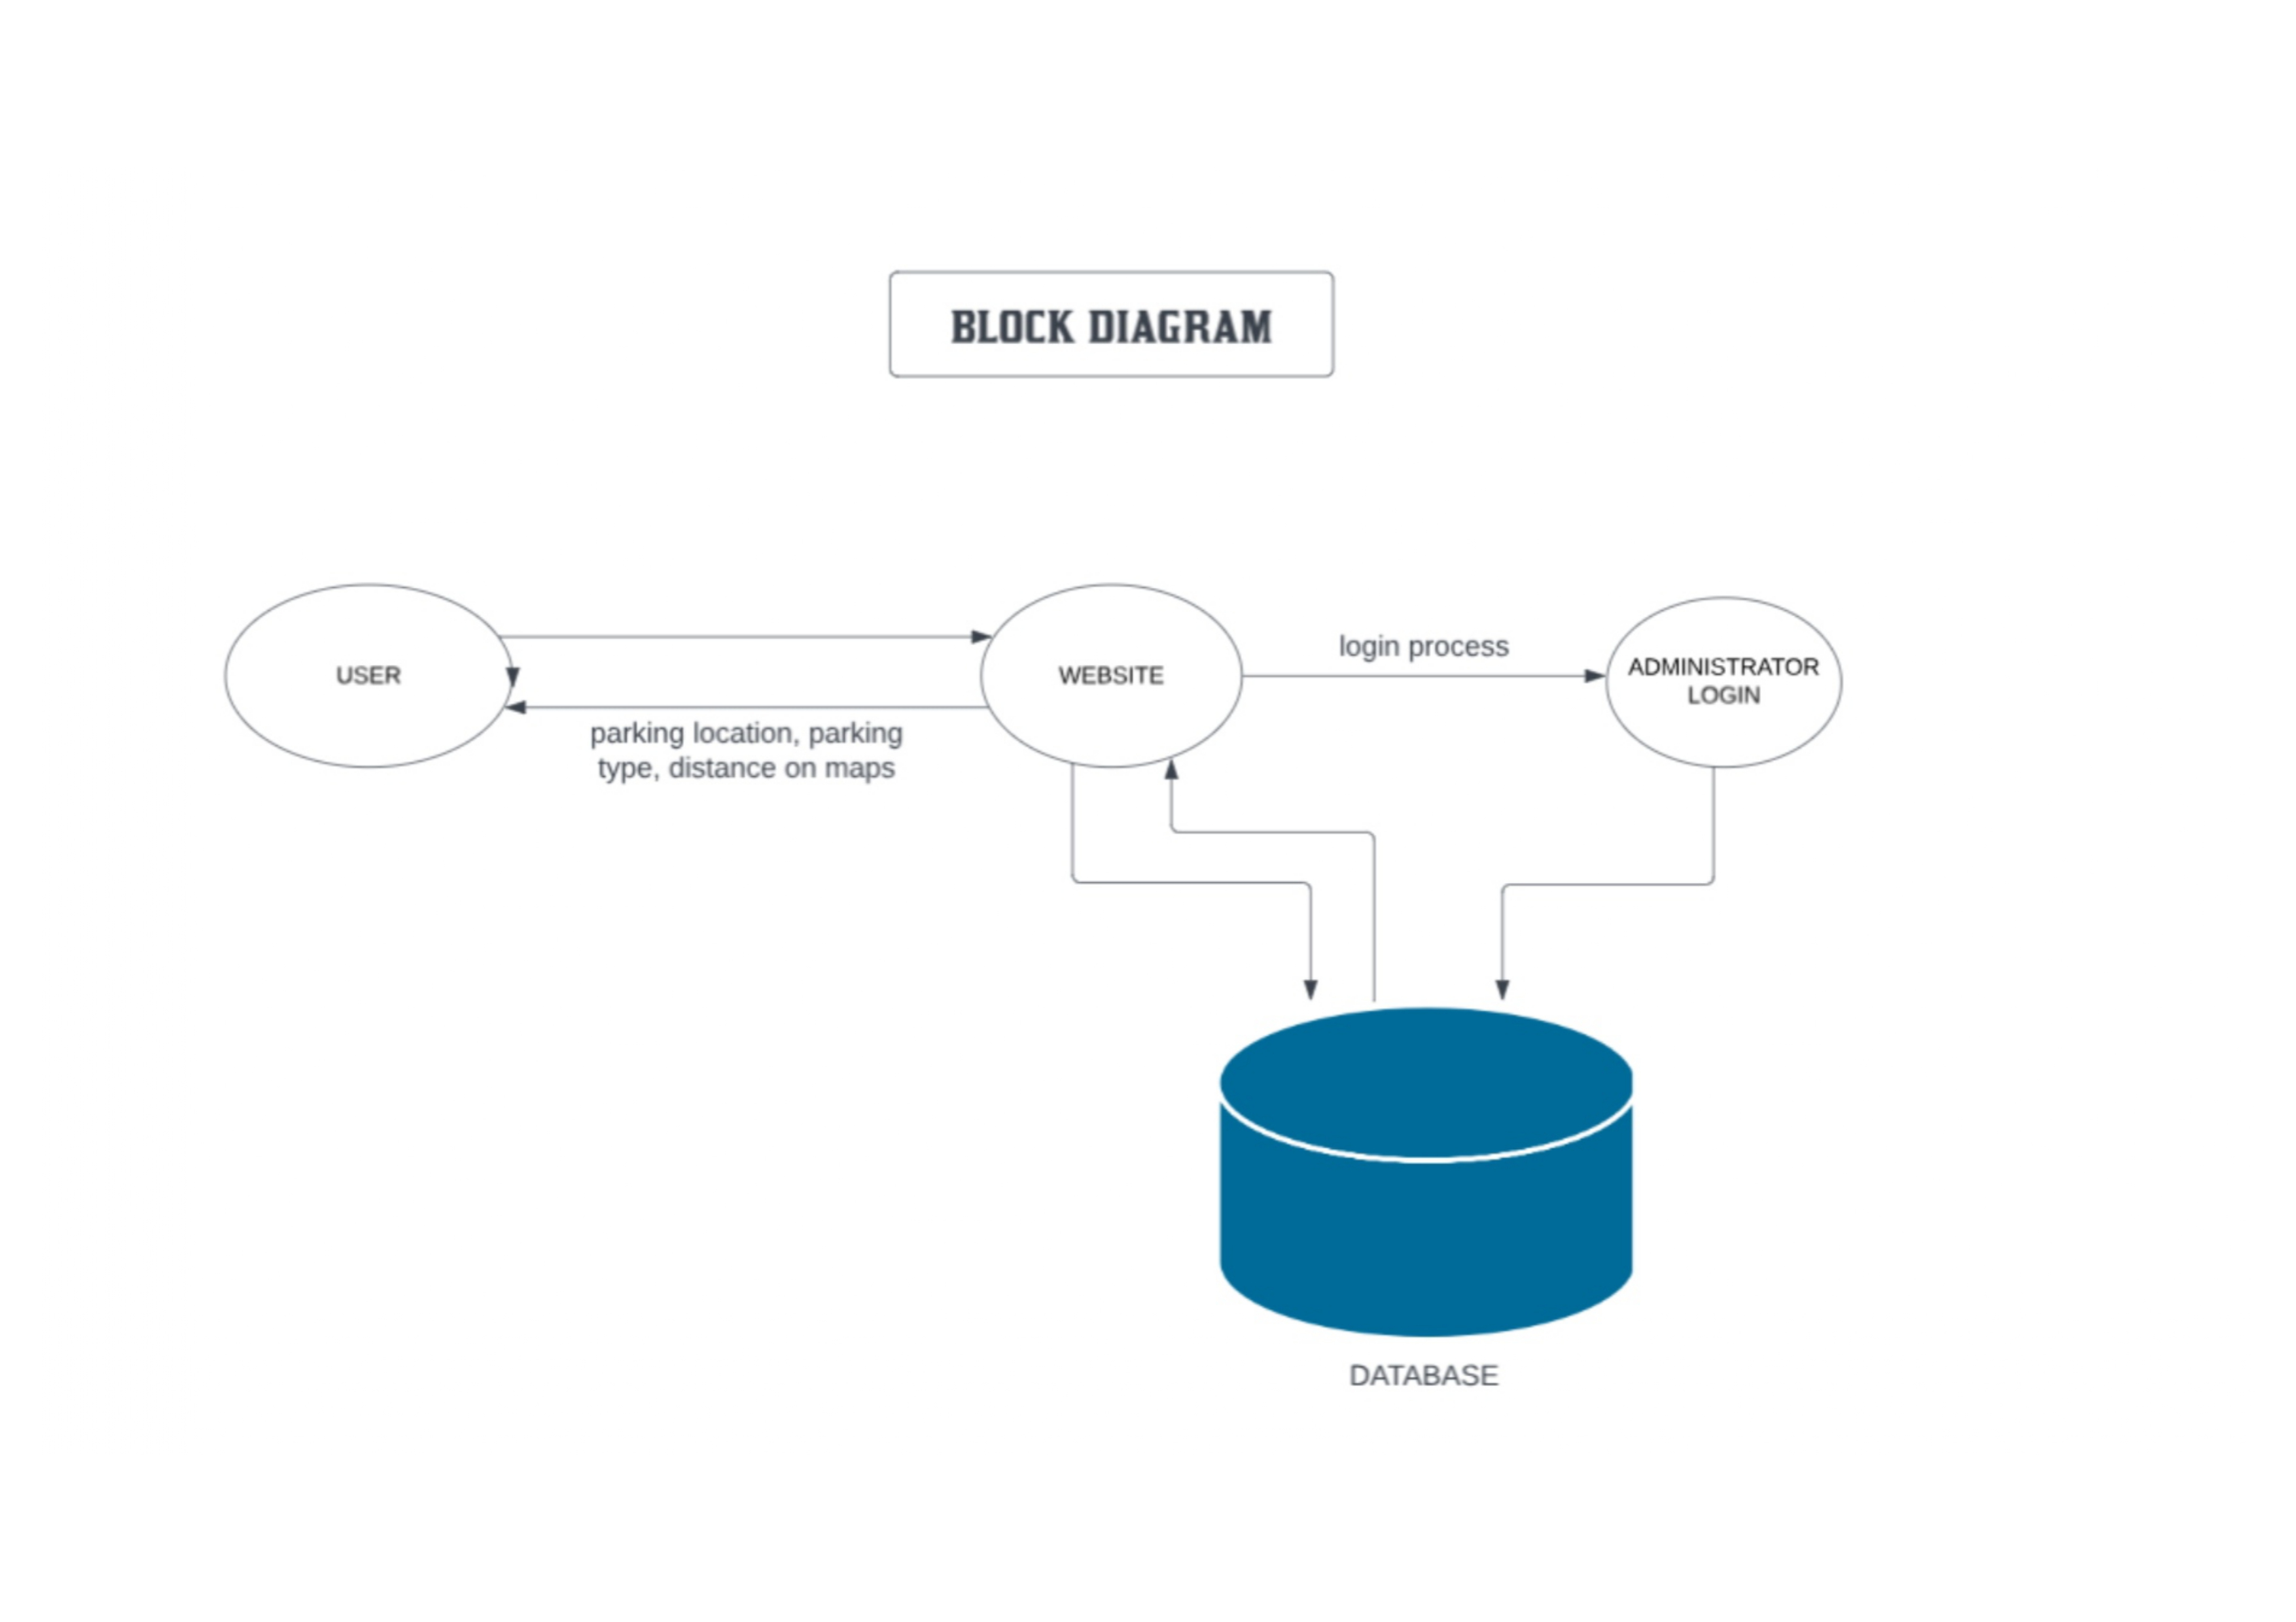
Block Diagram
Fig. 1 NAME OF FIGURE

Slide 7
Problem of Statement
1. Parking Space Availability:
Many urban areas suffer from a lack of available parking spaces, leading to frustration and wasted time for drivers searching for suitable parking spots.
2. Inefficient Parking Search Process:
The current methods for finding parking areas, such as relying on word-of-mouth recommendations or driving around aimlessly, are often time-consuming and ineffective.
3. Safety Concerns:
Some parking areas may be poorly lit or located in unsafe neighborhoods, posing a risk to drivers and their vehicles.
4. Limited Access to Information:
There may be a lack of centralized and up-to-date information about available parking areas, making it difficult for drivers to make informed decisions.

Slide 8
Expected Result
Discussed about the problems which is faced by many of the people while parking their vehicle.
Discussed about database for keeping each and every details of the user secure in the website.
Discussing the potential long-term effects of Urban Spotter on reducing congestion, enhancing accessibility, and promoting sustainable transportation options within urban areas..
Reflecting on the platform's contribution to improving urban mobility by facilitating easier and more efficient parking.
Discussing areas of improvement based on user feedback and suggestions to enhance the platform's usability and functionality.

Slide 9
Conclusion (Till Date)
Urban Spotter aims to revolutionize the parking experience by providing a user-friendly platform that simplifiesnthe process of finding and reserving parking spaces.Through the integration of advanced technology,transparent cost structure,and user driven feedback,we strive to offer a seamless and efficient solution for users seeking convenient and stress-free parking.Urban Spotter aspires to redefine the way individuals approach and experience parking,making it a positive and integral part of their journey.Join us on this journey towards a future where parking is not just a necessity but a hassle-free and enjoyable experience.

Slide 10
Work – Plan
Months Activities | JAN’24 | FEB’24 | MAR’24 | APR’24
Project Reviews | √ | √
Component Identification & Selection |  | √
Designing
coding
Experimental Analysis
Testing and Debugging
Preparation of Project Report
Thesis and Poster Submission

Slide 11
References
Dribble;
https://dribbble.com/

Slide 12
Thank you !

